Slide 1

My favourite sportsmen

Slide 2
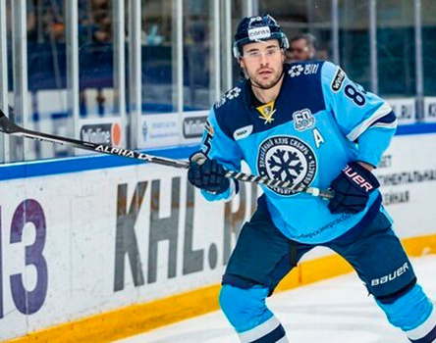
MY FAVOURITE ATHLETE IS…
Taylor Beck is a Canadian professional ice hockey. He plays for HC Sibir (Novosibirsk) of the Kontinental Hockey League.

Slide 3
His birthday is on 13th May. He's from Canada. Hi is 1.88 m. tall. Hi is 94 kg.

Slide 4
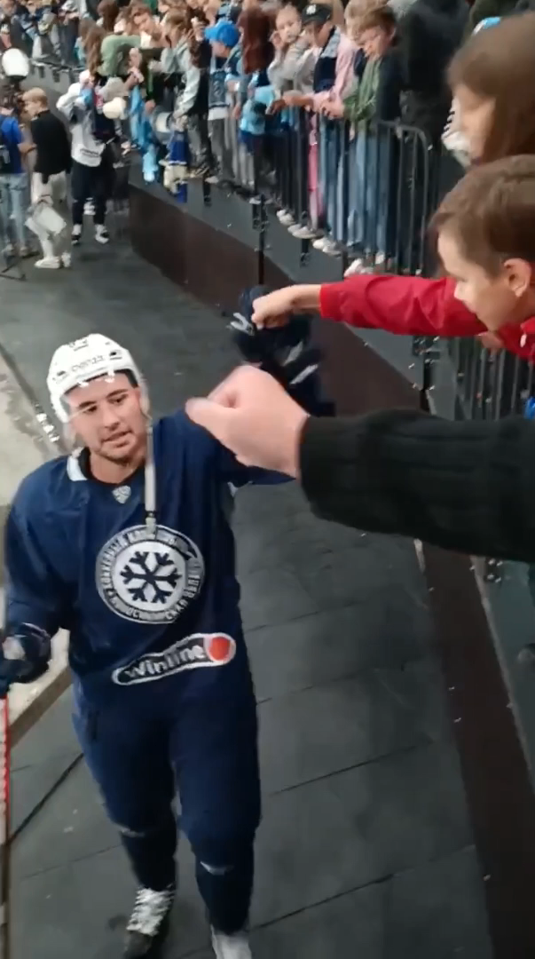
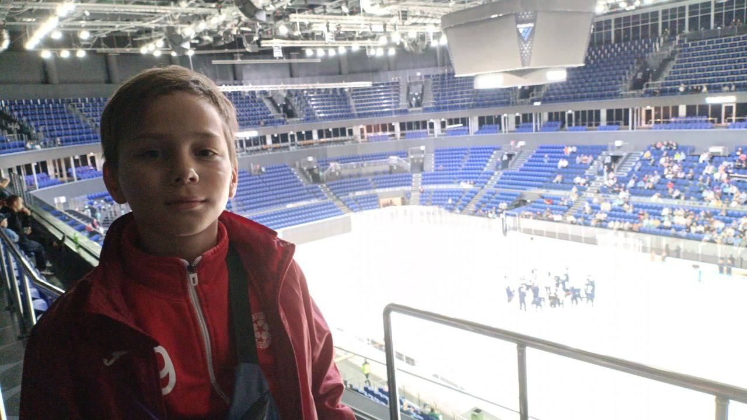
EVENT
One day I was at a training session with HC SIBERIA. I met my idol. He gave me a bump.

