Slide 1
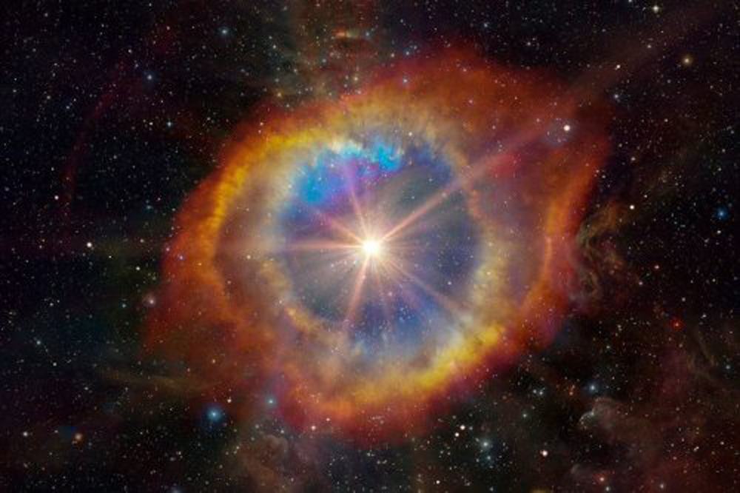
When massive stars run out of fuel, they end their lives in gigantic explosions called supernovas. These spectacular blasts are so bright that they can briefly outshine entire galaxies.
Extensive research and modern technologies have illuminated many details about supernovas, but how these massive explosions occur is still a mystery.
How do Stars Explode?
Scientists are keen to understand the mechanics of these stellar blasts, including what happens inside a star before it ignites as a supernova.

