Slide 1
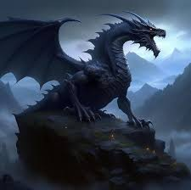
Fire-breathing Dragon
Dragon-big and scary monster from the depths of Baikal, and maybe live there now. For the first time legend appeared I the distant past, where it is said that t the bottom of lake Baikal lives dragon who control all the animals there.
And when appeared world, arrived gold coach, and the dragon came out from there. And when he slapped his tail on the ground, appared lake and he jumped there. People who started live near the lake worshipped him every 120 years. But, people began to forget about worship, and then the Dragon got angry and kill people by floating them with water all the way to the ocean.
And they say that when studying the bottom of the lake ,they saw a creature aboyt 30 metres in length

