Slide 1
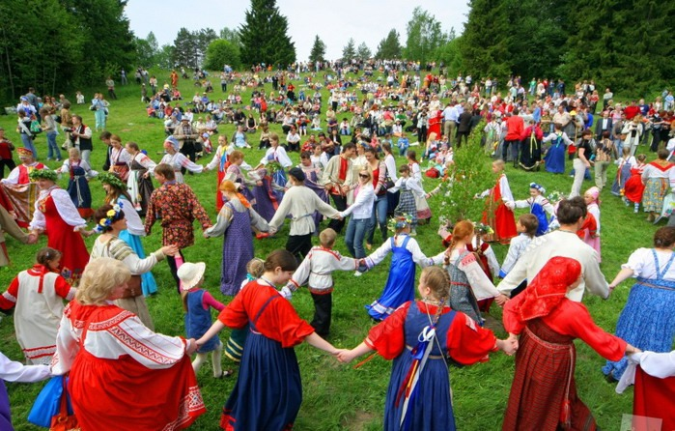
Festival
Festivals are constantly held throughout the country. They are often associated with some important dates. Sometimes this is tradition. I think that anyone will be happy to participate in the festival.
In our school, the festival is held every 4 years and this is a tradition. All classes prepare their performances for several months.
In our class this year the theme of Russian souvenirs. Our class is already rehearsing several different scenes and practicing dancing. There are ideas for the main poster of the festival.
I am sure that the festival at the school will be great and everyone will be happy. I hope that next time the quality of the students' performances will only improve.

