Slide 1
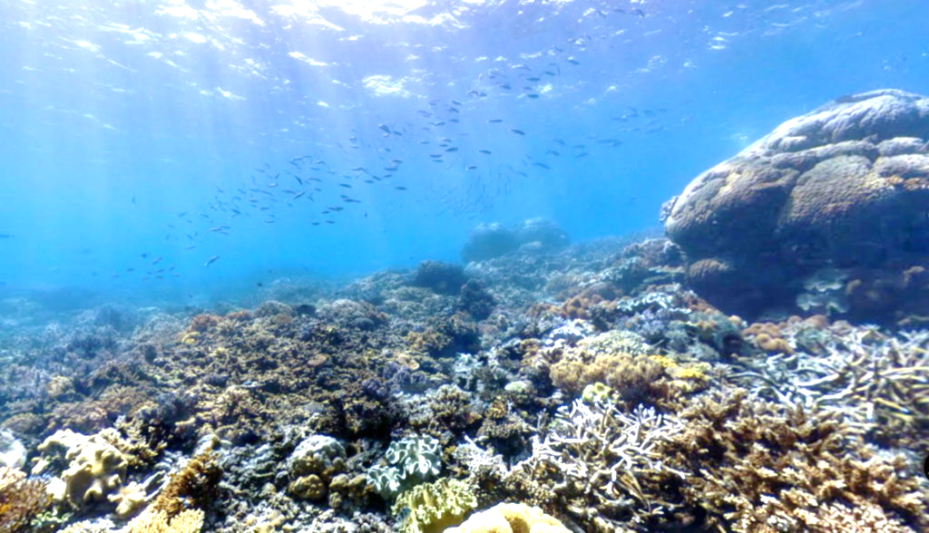
Australia

Slide 2
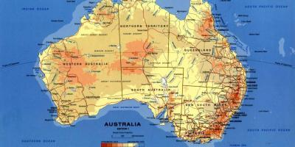
Australia is country in oceania.
Australia is a country located in ocean and has population of 25 million inhabitants. 4 million tourists come to Australia every year.

Slide 3
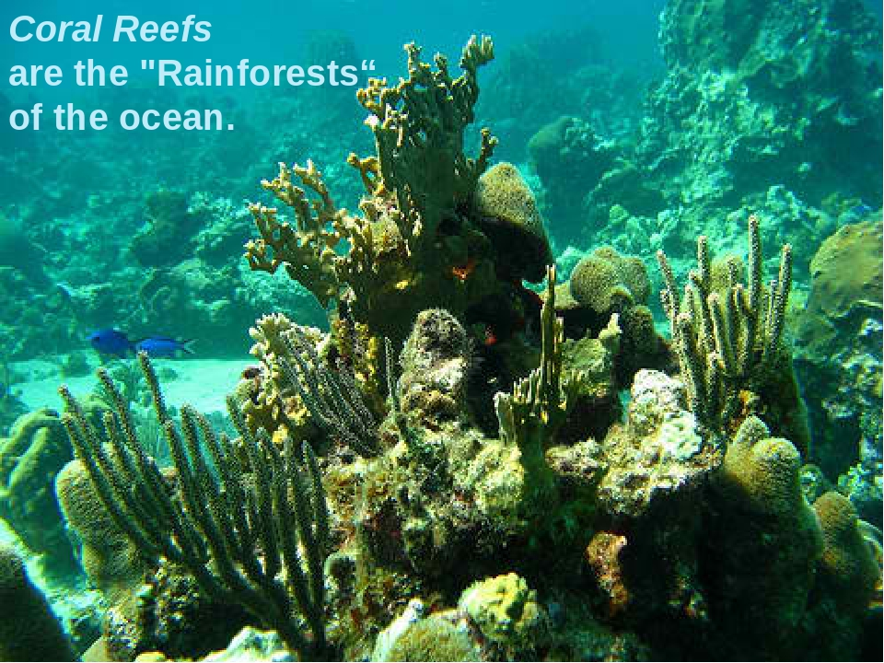

Slide 4
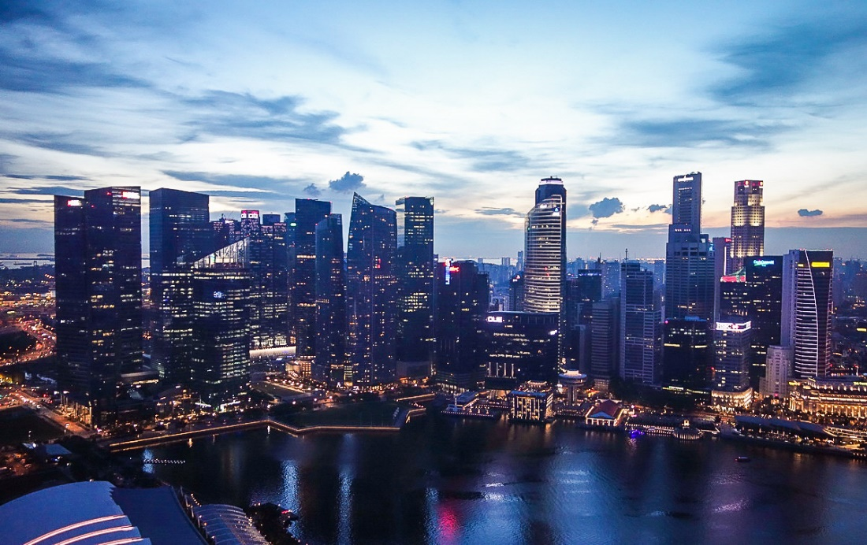
QUESTION:
What is the capital of Australia?

Slide 5
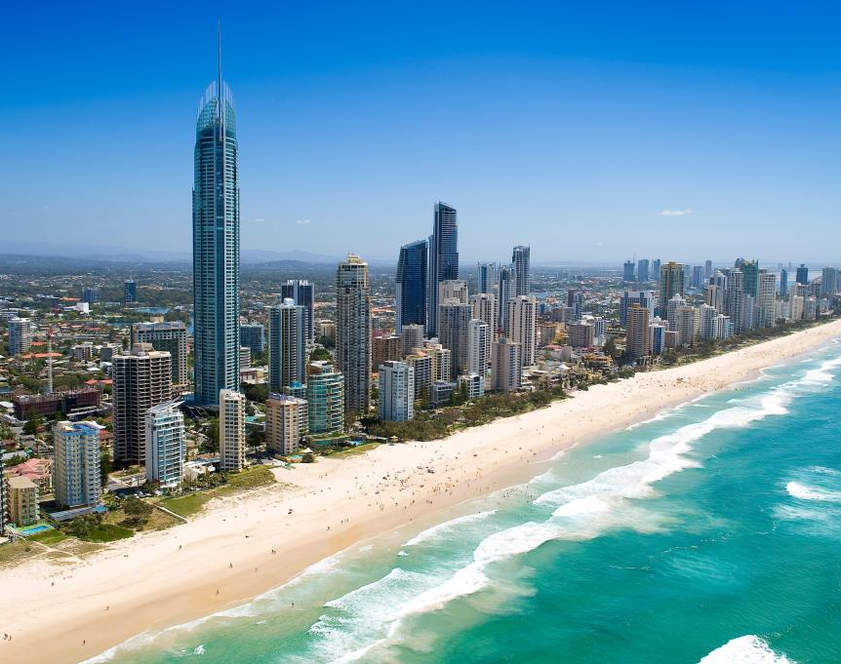
ANSWER
CANBERRA

Slide 6
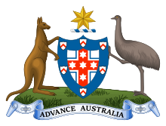
The iconic animals of Australia are the Kangaroo and the Peacock. They are depicted on the coat of arms.

Slide 7
